Slide 1

AWS Analytics
Introduction and Labs

Slide 2


Tell Us a Little About Yourself
Please let us know who you are:
Name and role
Database, Analytics, Cloud experience
Why you are attending this course
What you expect to learn
What is your definition or perception of AWS and Analytics?
2
Notes:
Presenter
2018-07-23 15:23:32
--------------------------------------------
Be brief but don’t rush!

Slide 3


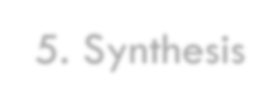

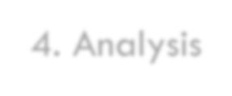





About Bloom’s Taxonomy
6. Evaluation
5. Synthesis
4. Analysis
3. Application
2. Comprehension
1. Knowledge
This Course
Bloom’s Taxonomy is used to categorize learning objectives and, from there, assess learning achievements.
3
Notes:
Presenter
2018-07-23 15:23:33
--------------------------------------------
Key concepts:
Briefly discuss Bloom’s taxonomy
Benjamin Bloom was an American educational psychologist
Simply put, Bloom’s Taxonomy helps teachers categorize learning objectives and, from there, assess learning achievements The DevOps Foundation exam will contain Bloom 1 questions that test learning participants’ knowledge of DevOps concepts The exam will also contain Bloom 2 questions that test their comprehension of these concepts
Bloom 2 questions are more example oriented, and require that learners think about what they’ve learned and demonstrate their understanding

Slide 4
Agenda and Schedule
Day Number | Topic
1 | AWS Data Lakes and Analytics
1 | Introduction to Amazon Kinesis Streams
1 | Introduction to Amazon Kinesis Analytics
2 | Introduction to Amazon EMR
2 | Introduction to AWS Glue
2 | Introductino to Amazon Athena
3 | Introduction to AWS Lake Formation
3 | Introduction to Redshift + Architecture
3 | Data Ingestion/Loading into Redshift
4 | Redshift Use Cases
4 | Redshift Cluster
4 | Redshift with historical data in S3

Slide 5
Agenda and Schedule
Day Number | Topic
5 | Kinesis Data Firehose
5-6 | Kinesis Data Stream Sample Project
6 | Kinesis on the fly data transformatino with Lambda
7 | Athena and Glue Architecture
7 | Glue Crawlers
8 | Athena Queries from S3 Bucket
8 | Integration with Third Party tools
9 | EMR Architecture
9 | Introduction to QuickSight

Slide 6
Agenda and Schedule
Day Number | Topic
10 | EMR Sample Project
10 | Place holder for any other items
10 | Lambda Layers for custom languages/Packages
11 | MSK Introduction and Use Cases
11 | Introductino to Glue Databrew
12 | Introductino to Database Migration Service
12 | Introduction to RDS and RDS Aurora for read replica

Slide 7
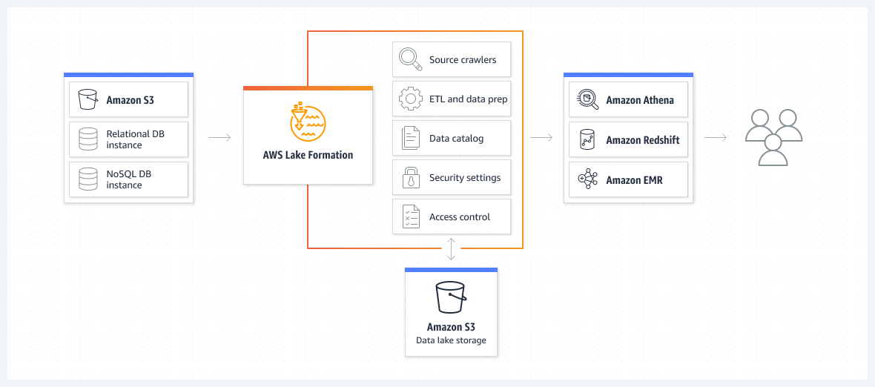
Amazon Lake Formation

Slide 8
Lake Formation Terminology
Data Lake
The data lake is your persistent data that is stored in Amazon S3 and managed by Lake Formation using a Data Catalog. A data lake typically stores the following:
Structured and unstructured data
Raw data and transformed data For an Amazon S3 path to be within a data lake, it must be registered with Lake Formation.
Data Access
Lake Formation provides secure and granular access to data through a new grant/revoke permissions model that augments AWS Identity and Access Management (IAM) policies. Analysts and data scientists can use the full portfolio of AWS analytics and machine learning services, such as Amazon Athena, to access the data. The configured Lake Formation security policies help ensure that users can access only the data that they are authorized to access.

Slide 9
Lake Formation Terminology
Blueprint
A blueprint is a data management template that enables you to easily ingest data into a data lake. Lake Formation provides several blueprints, each for a predefined source type, such as a relational database or AWS CloudTrail logs. From a blueprint, you can create a workflow. Workflows consist of AWS Glue crawlers, jobs, and triggers that are generated to orchestrate the loading and update of data. Blueprints take the data source, data target, and schedule as input to configure the workflow.
Workflow
A workflow is a container for a set of related jobs, crawlers, and triggers in AWS Glue. In Lake Formation, you create a workflow from a blueprint. A workflow encapsulates a complex multi-job extract, transform, and load (ETL) activity that AWS Glue can execute and track as a single entity. You can visually track the status of the different nodes in the workflow on the AWS Management Console, making it easier to monitor progress and troubleshoot. You can also share parameters across entities in the workflow. When you define a workflow, you select the blueprint upon which it is based. You can then run workflows on demand or on a schedule. Each workflow manages the execution and monitoring of all its defined jobs and crawlers. When a workflow has completed, the user who ran the workflow is granted Lake Formation data permissions on the Data Catalog tables that the workflow creates. Workflows that you create in Lake Formation are visible in the AWS Glue console.

Slide 10
Lake Formation Terminology
Data Catalog
The Data Catalog is your persistent metadata store. It is a managed service that lets you store, annotate, and share metadata in the AWS Cloud in the same way you would in an Apache Hive metastore. It provides a uniform repository where disparate systems can store and find metadata to track data in data silos, and then use that metadata to query and transform the data. Lake Formation uses the AWS Glue Data Catalog to store metadata about data lakes, data sources, transforms, and targets. Metadata about data sources and targets is in the form of databases and tables. Tables store schema information, location information, and more. Databases are collections of tables. Lake Formation provides a hierarchy of permissions to control access to databases and tables in the Data Catalog. Each AWS account has one Data Catalog per AWS Region.
Underlying Data
Underlying data refers to the source data or data within the data lakes that Data Catalog tables point to.
Principal
A principal is an AWS Identity and Access Management (IAM) user or role that does work in Lake Formation.
Data Lake Administrator
User who can register Amazon S3 locations, access the Data Catalog, create databases, create and run workflows, grant Lake Formation permissions to other users, and view AWS CloudTrail logs. Has fewer IAM permissions than the IAM administrator, but enough to administer the data lake. Cannot add other data lake administrators.

Slide 11



Athena & Glue

Slide 12
DATA

Slide 13
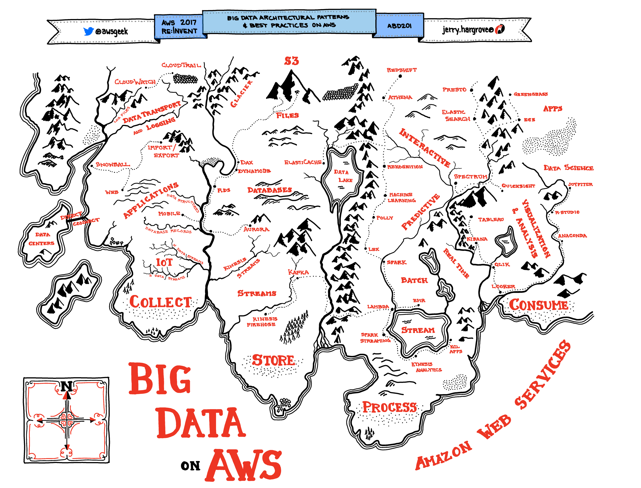

Slide 14
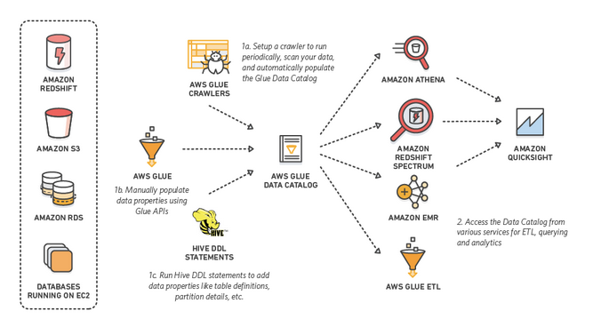
Glue & Athena

Slide 15
















Data in AWS
Streaming Data
Databases / Warehouse
Lake Formation
Data Pipeline
Database Migration Service
Files
RDS
Timestream
Kinesis
Managed Streaming for Kafka
DynamoDB
DocumentDB
EFS
S3
Neptune
QLDB
Amazon Redshift
Amazon Elastic Block Store (EBS)
Amazon FSx

Slide 16
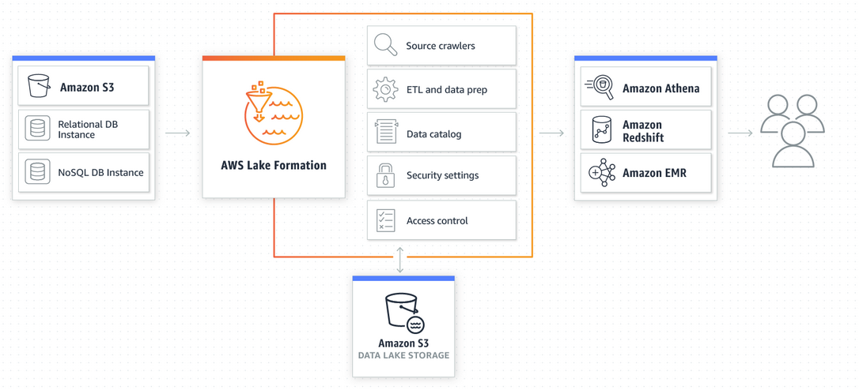
Lake Formation

Slide 17

Serverless Data Transformation
Pay for only what you use (storage / data transfer separate)
Crawl data (ad-hoc or scheduled)
Query data that’s Unstructured, Semi Structured or Structured.
Catalog data into a metastore (much like Hive)
Can Connect to JDBC/ODBC datasource or S3
Outputs to tooling like SageMaker, QuickSight, RedShift, S3, RDS
Can use 3rd party Analytics tooling

Slide 18
Compliance & Security
Athena & Glue are SOC 1,2,3 compliant as well as PCI, HIPPA & FedRAMP compliant.
Encryption @Rest
Encryption in flight
Fine Grained IAM Permissions
Workgroups
Security on Glue Data Catalog

Slide 19
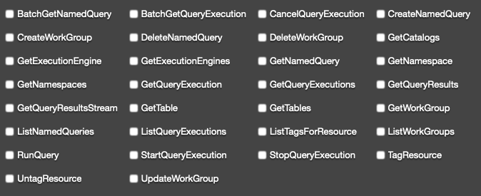
Athena IAM Policy

Slide 20
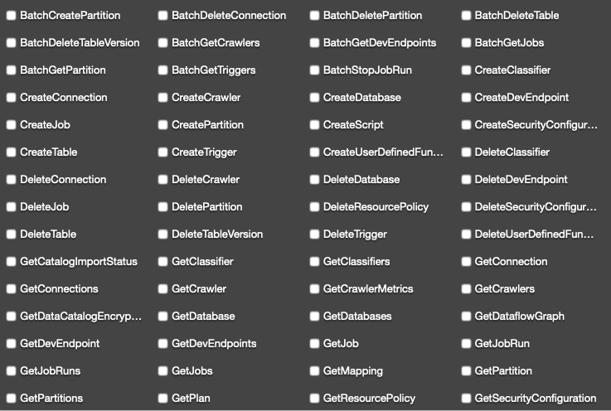
Glue IAM Policy

Slide 21
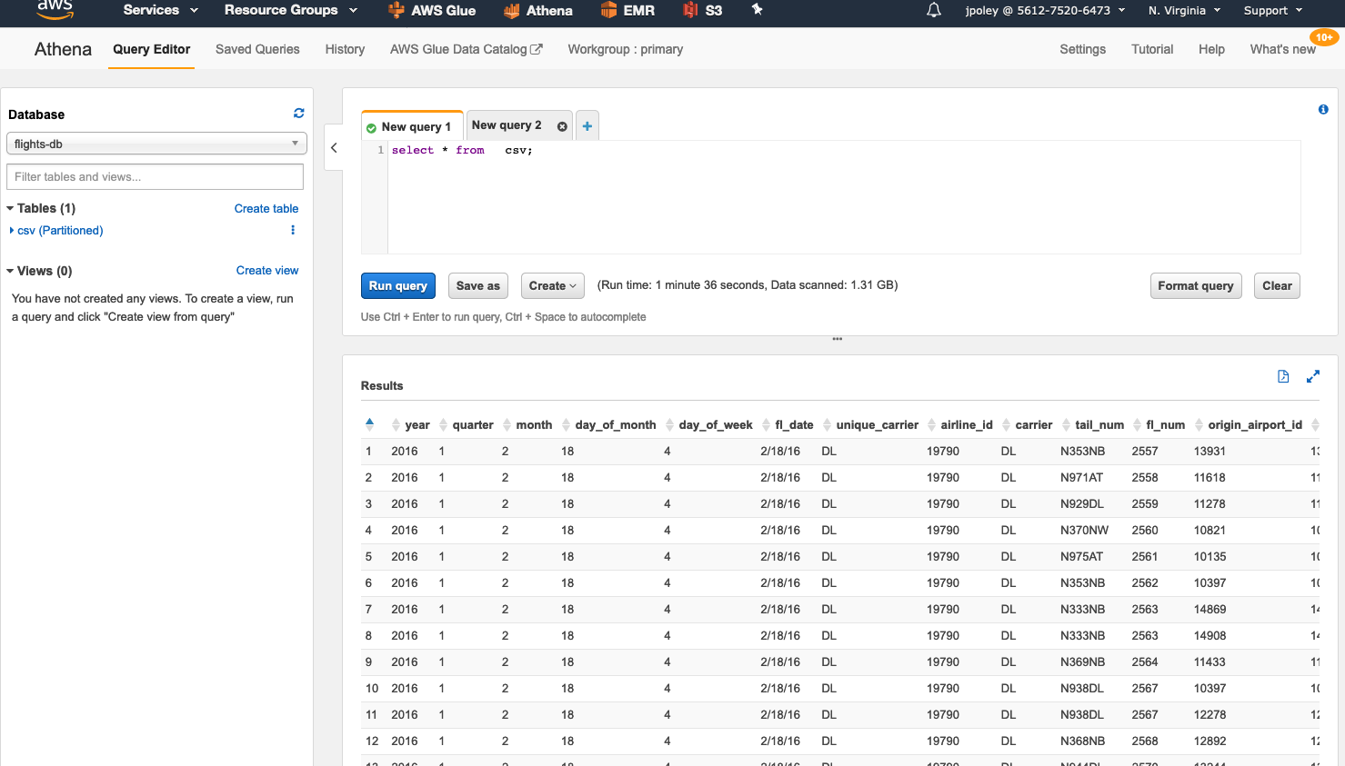
Athena
Serverless Query (SQL) on top of S3.

Slide 22


http://prestodb.github.io/
Presto is an open source distributed SQL query engine for running interactive analytic queries against data sources of all sizes ranging from gigabytes to petabytes.
Presto was designed and written from the ground up for interactive analytics and approaches the speed of commercial data warehouses while scaling to the size of organizations like Facebook.

Slide 23
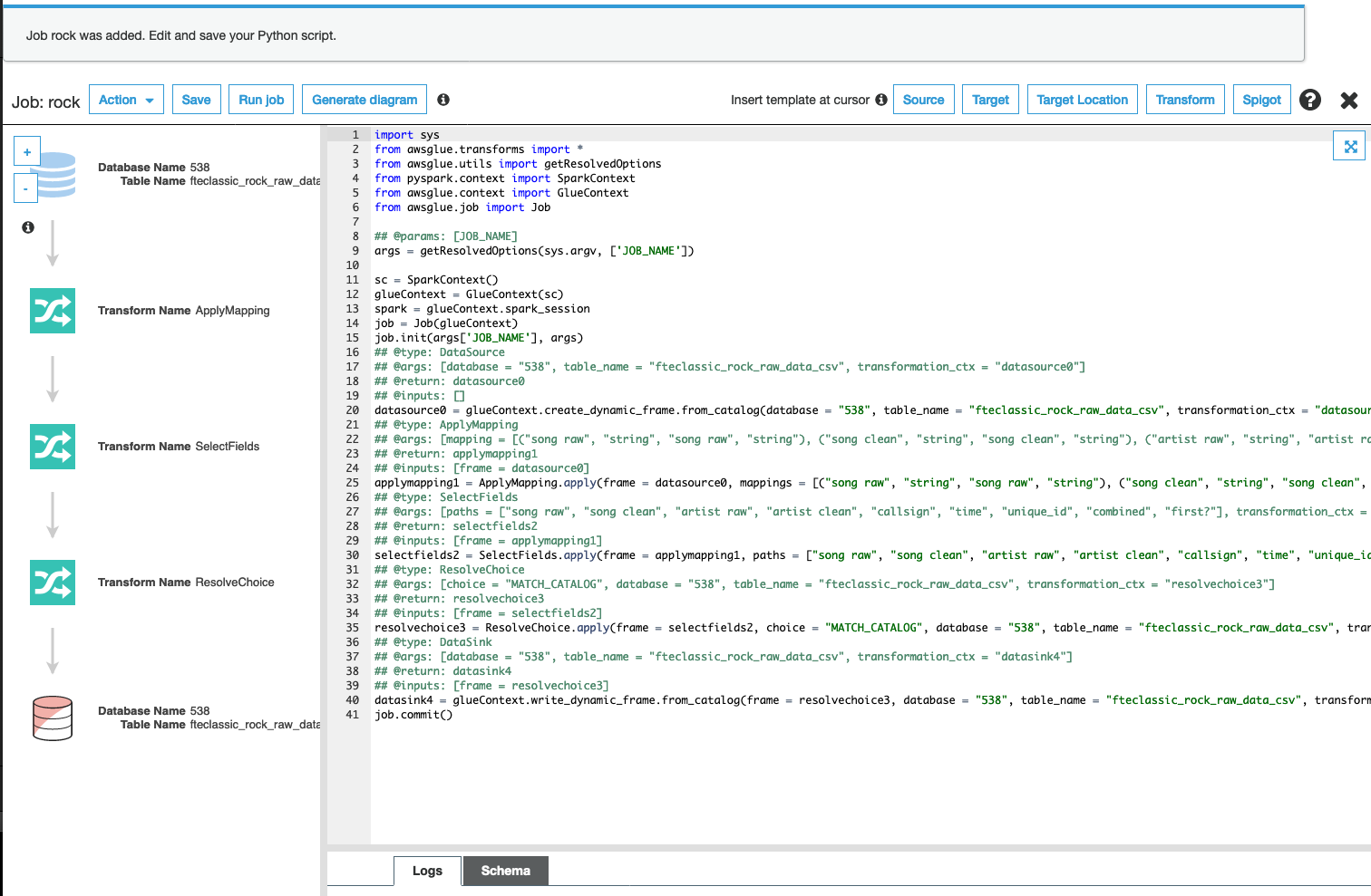
Glue
Triggers
Crawlers
Jobs
Connections

Slide 24

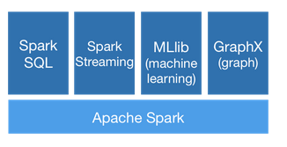
https://spark.apache.org/
Spark is a general-purpose distributed data processing engine that is suitable for use in a wide range of circumstances.
On top of the Spark core data processing engine, there are libraries for SQL, machine learning, graph computation, and stream processing, which can be used together in an application.
Code Written in Python / Scala (AWS)

Slide 25
Glue - Pros & Cons
Pros
Simple & Serverless
Lots of Integrations
Security Model
Fast to get started
Pay for Usage
Cons
Versioning
Vertical Autoscaling

Slide 26
Athena – Pros & Cons
Pros
Simple & Serverless
Pay for Usage
Rapid Prototyping
Cheaper Storage
Cons
No support for custom Functions

Slide 27


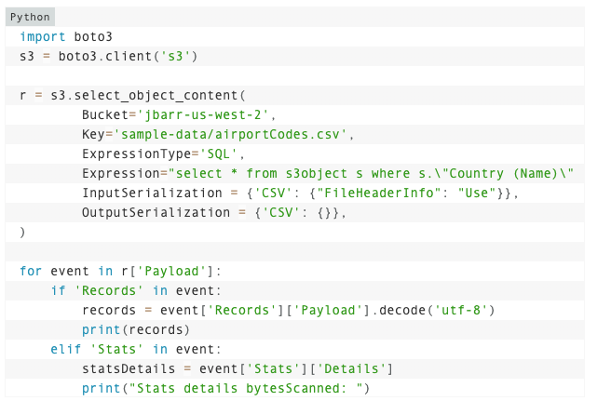
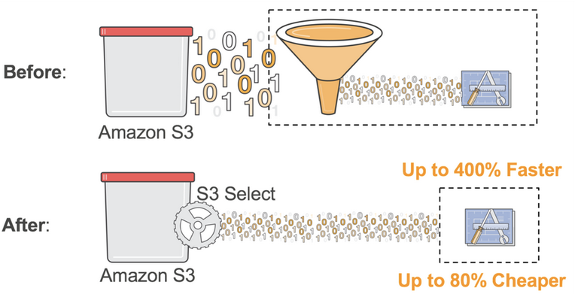
S3 & Glacier Select
https://aws.amazon.com/blogs/aws/s3-glacier-select/
enables applications to retrieve only a subset of data from an object by using simple SQL expressions. By using S3 Select to retrieve only the data needed by your application, you can achieve drastic performance increases – in many cases you can get as much as a 400% improvement.

Slide 28

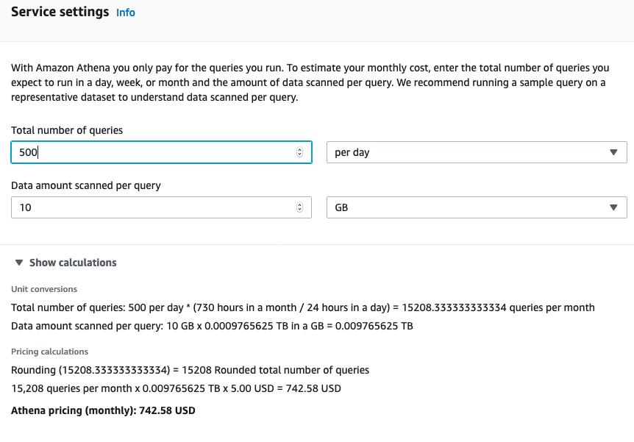
Athena Pricing

Slide 29
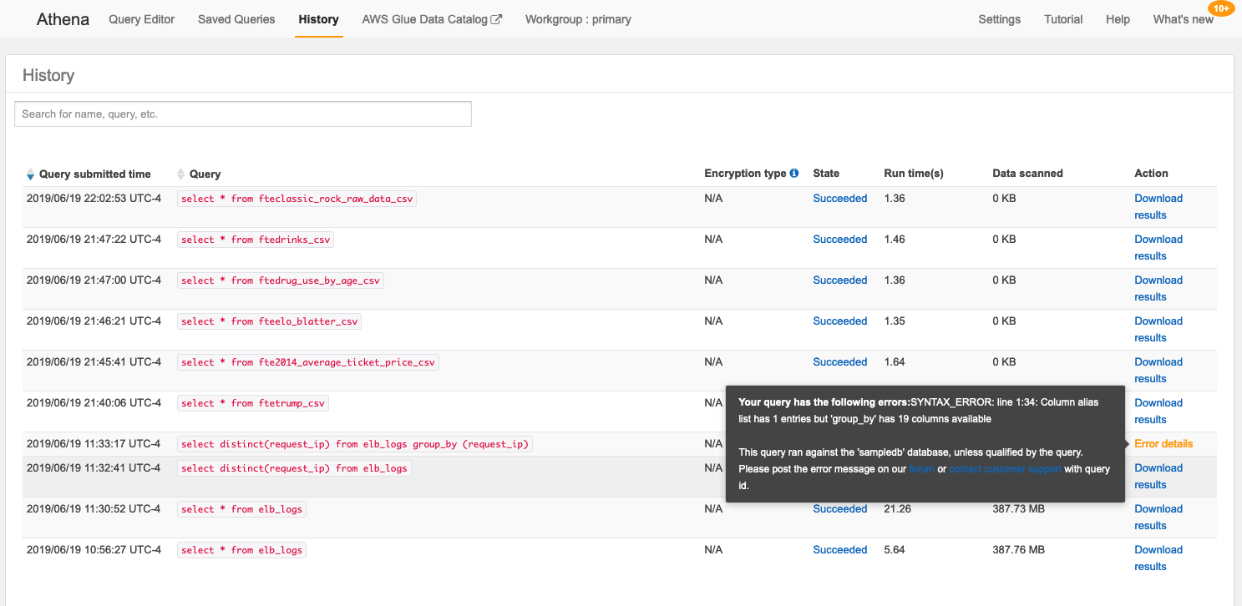
Athena History

Slide 30
Glue Pricing
$0.44 per DPU-Hour, billed per second, with a 10-minute minimum for each ETL job of type Apache Spark
$0.44 per DPU-Hour, billed per second, with a 1-minute minimum for each ETL job of type Python shell
$0.44 per DPU-Hour, billed per second, with a 10-minute minimum for each provisioned development endpoint
DPU = Data Processing Unit = 4 vCPU & 16 GB Memory
Spark requires 2 DPU where Python Shell can run on less

Slide 31
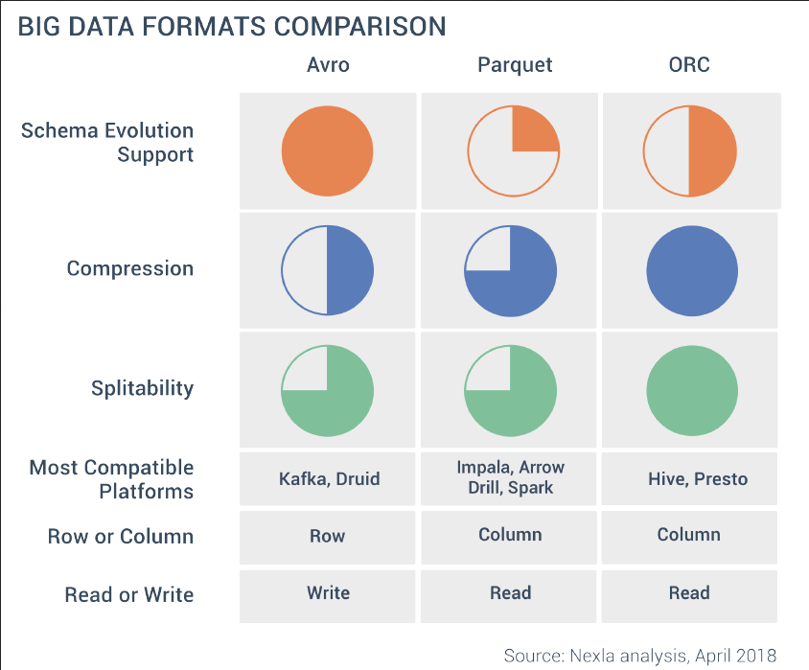
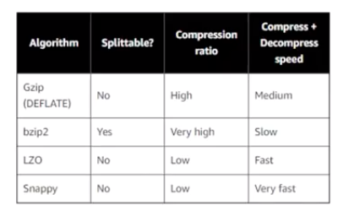
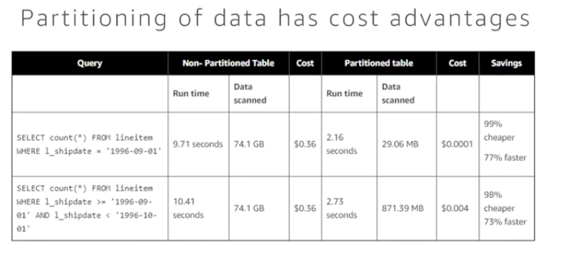
File Formats

Slide 32
SerDes
Data Format | Description | SerDe types supported in Athena
CSV (Comma-Separated Values) | For data in CSV, each line represents a data record, and each record consists of one or more fields, separated by commas. | Use the LazySimpleSerDe for CSV, TSV, and Custom-Delimited Files if your data does not include values enclosed in quotes. Use the OpenCSVSerDe for Processing CSV when your data includes quotes in values, or different separator or escape characters.
TSV (Tab-Separated Values) | For data in TSV, each line represents a data record, and each record consists of one or more fields, separated by tabs. | Use the LazySimpleSerDe for CSV, TSV, and Custom-Delimited Files and specify the separator character as FIELDS TERMINATED BY '\t'.
Custom-Delimited | For data in this format, each line represents a data record, and records are separated by custom delimiters. | Use the LazySimpleSerDe for CSV, TSV, and Custom-Delimited Files and specify custom delimiters.
JSON (JavaScript Object Notation) | For JSON data, each line represents a data record, and each record consists of attribute–value pairs and arrays, separated by commas. | Use the Hive JSON SerDe. Use the OpenX JSON SerDe.
Apache Avro | A format for storing data in Hadoop that uses JSON-based schemas for record values. | Use the Avro SerDe.
ORC (Optimized Row Columnar) | A format for optimized columnar storage of Hive data. | Use the ORC SerDe and ZLIB compression.
Apache Parquet | A format for columnar storage of data in Hadoop. | Use the Parquet SerDe and SNAPPY compression.
Logstash logs | A format for storing logs in Logstash. | Use the Grok SerDe.
Apache WebServer logs | A format for storing logs in Apache WebServer. | Use the RegexSerDe for Processing Apache Web Server Logs.
CloudTrail logs | A format for storing logs in CloudTrail.

Slide 33
Schema on Read vs Schema on Write
Schema on Write
Faster results
Structured
Not flexible
SQL
Schema on Read
Slower results
Unstructured
Very Flexible
No DDL - SQL

Slide 34

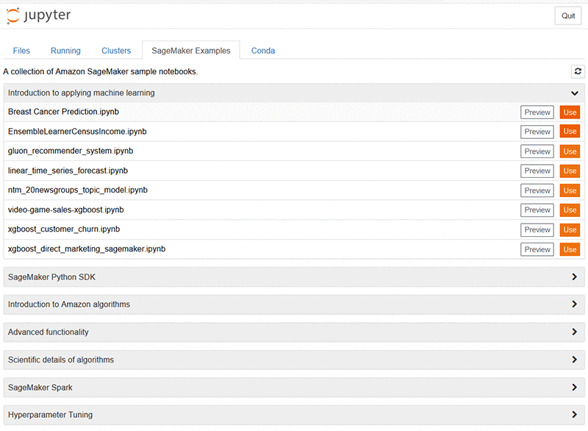

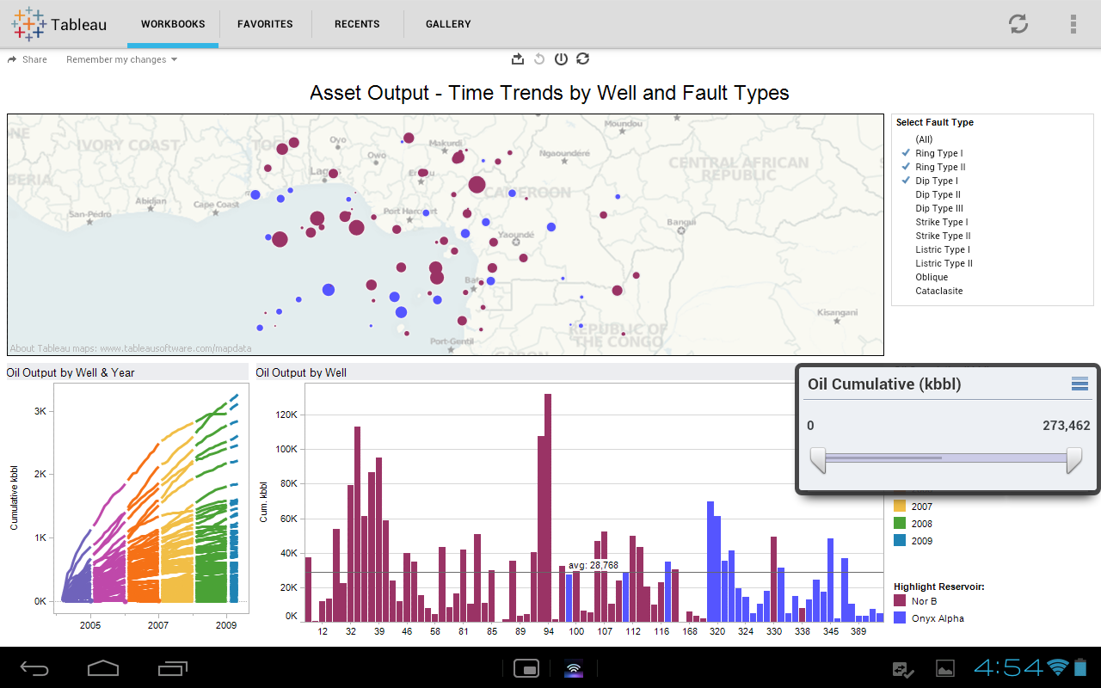
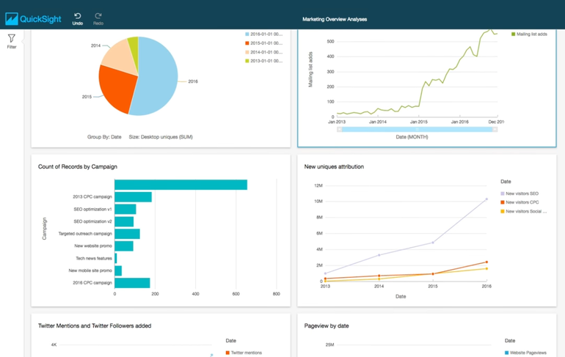


Common Query Output Destinations
SageMaker
Amazon QuickSight

Slide 35
Best Practices & Optimizations
Compress Files (see format specifics)
Partition Information
Use Columnar Format
Consider Extract Step
Frequently Used Athena Queries

Slide 36
Comparison to Other Solutions
Spark
Presto
Airflow
Flink
Kafka
NiFi
CloverETL
Talend
Ab Initio
Attunity
Informatica
Pentaho
SSIS
Oracle GoldenGate
S3 Select
Data Pipeline
Hive
EMR – Sqoop
AWS Batch
AWS SWF
AWS Step Functions
Redshift Spectrum
SnowFlake
Google BigQuery
Google Dataflow
Azure ETL
Datapine
https://github.com/pawl/awesome-etl

Slide 37
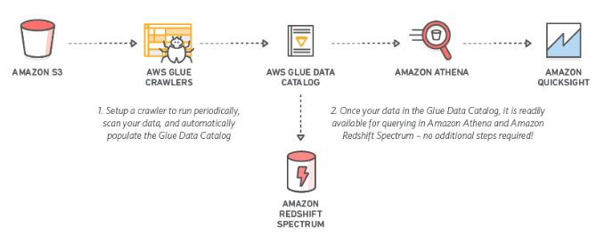
Simple Examples

Slide 38
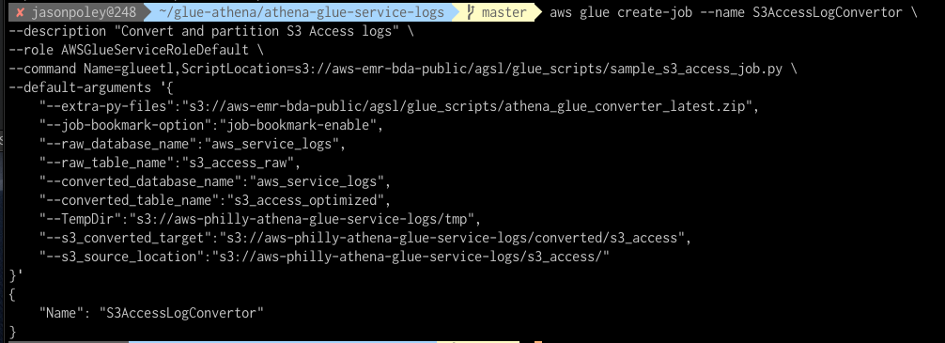
AWS Use Cases
VPC Flow Logs Capture
Cloudtrail with S3 Object Lock
AWS Config Logs
AWS Macie Logs
WebLogs
AWS Billing Data
CloudWatch Log Data
https://aws.amazon.com/blogs/big-data/easily-query-aws-service-logs-using-amazon-athena/

Slide 39
